Slide 1


By: Shazia Patel
Prof: Mrs. Holley
(NOS 125-Ansible) Automate Server management

Slide 2
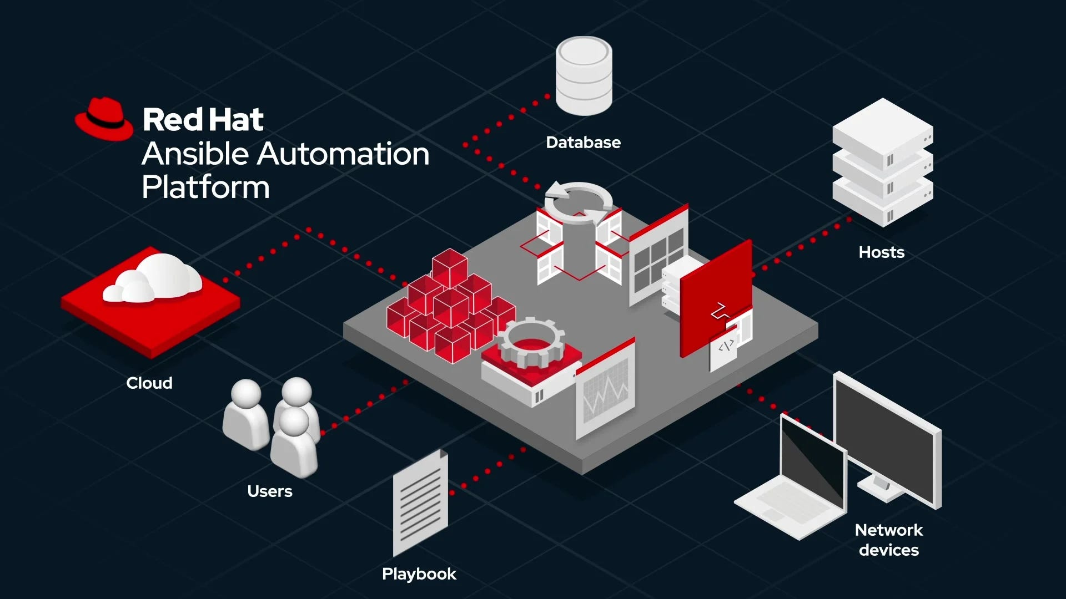
Introduction to Automation with Ansible
What is Ansible?
01
Why we use it?
02
A tool that automates repetitive tasks on servers.
Makes sure tasks are done consistently and reliably.
Reduces manual work.
Avoids human errors.
Saves time when managing multiple servers.

Slide 3
Our Scenario
We have 2 servers: servera and serverb.
We need to:
1. Install necessary software packages.
2. Make sure the software is running correctly.
3. Create groups and users for system administration.
4. Handle errors automatically if something goes wrong.
Server A
--ssh--
Ansible
--ssh--
Server B

Slide 4
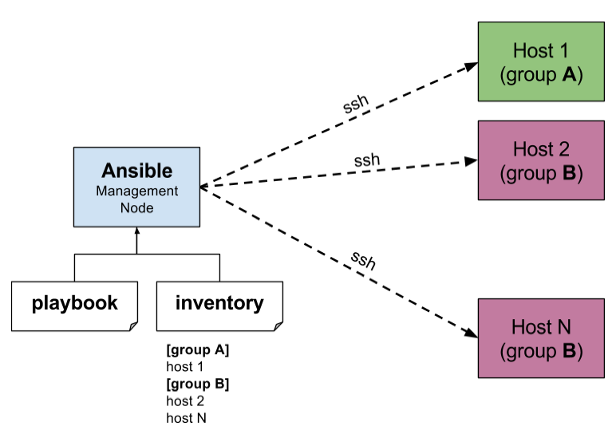
How Ansible Works
Think of Ansible as a chef following a recipe:
1. Check what’s already on the server.
2. Install missing software.
3. Start and enable services so they run automatically.
4. Create groups and users for administration.
Report success or failure for each step.
The instructions are written in a playbook, which is just a list of tasks for Ansible to follow.

Slide 5
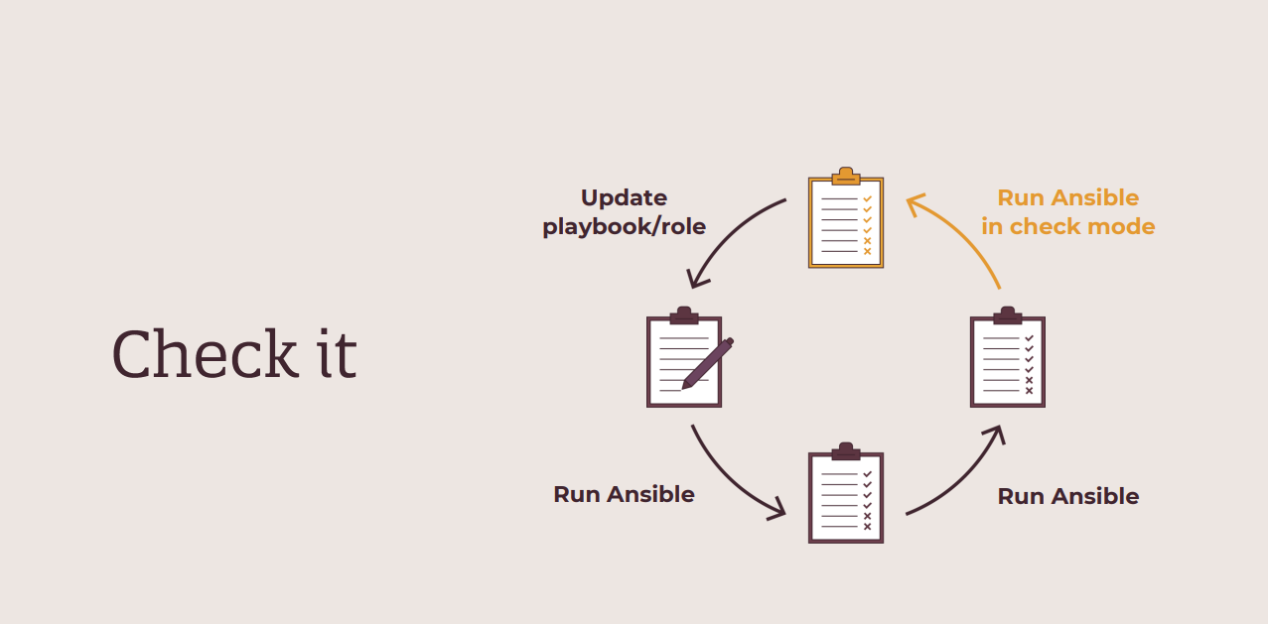
Testing Before Production
First, we test on serverc to make sure nothing breaks.
We install the packages, check them, then remove them.
Ensures that our changes are safe before touching the main servers.

Slide 6
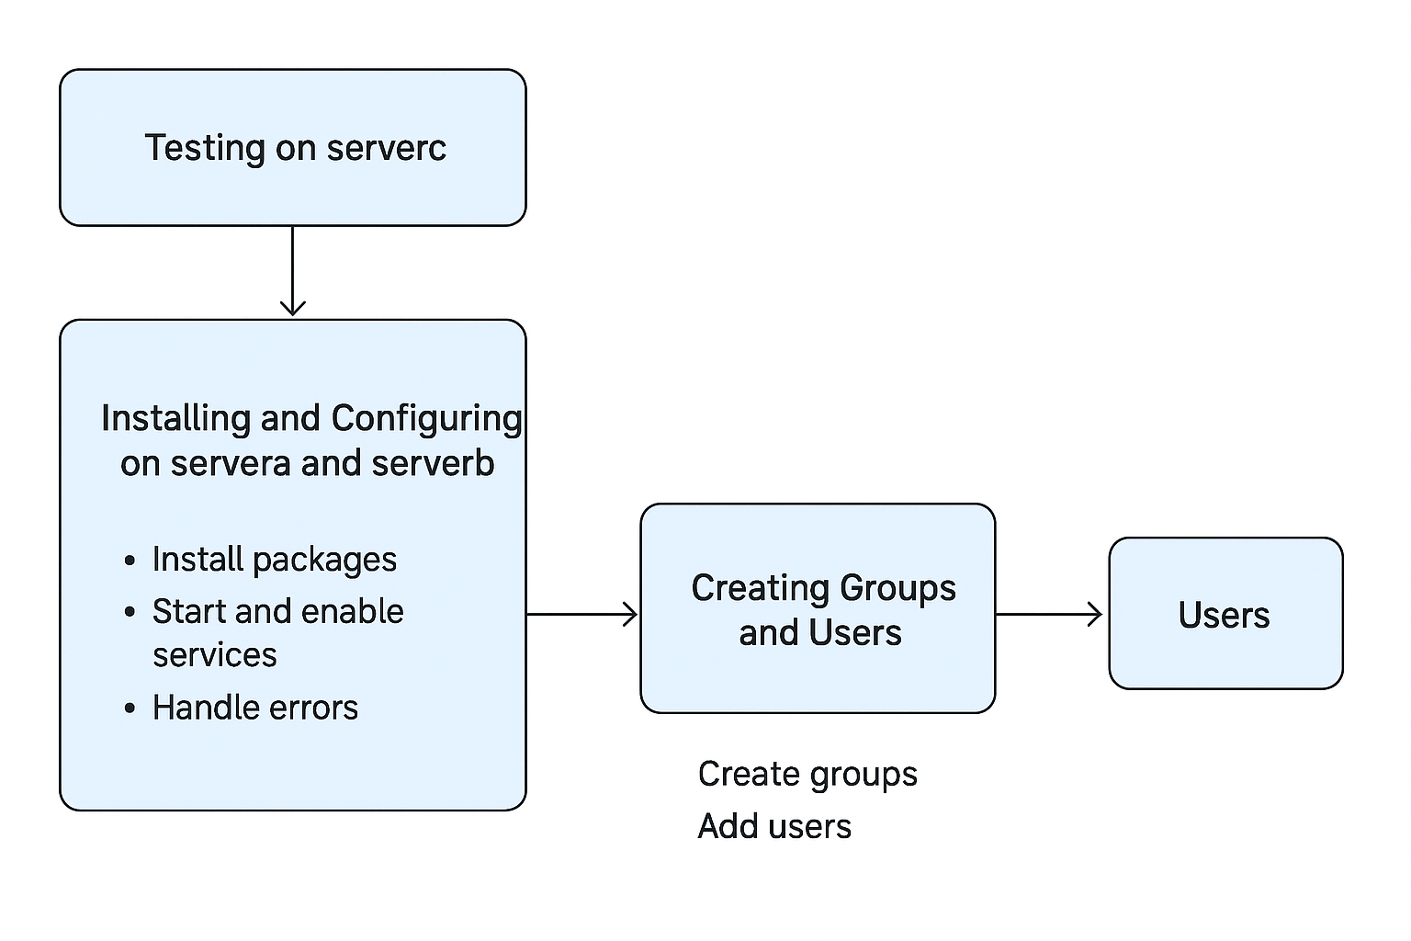
Installing and Managing Software
On servera and serverb:
o Ansible installs HTTP server, database server, and firewall.
o Automatically starts these services.
o Ensures services stay running after reboot.
Error handling: If installation fails, Ansible logs it and continues without stopping.

Slide 7
Managing Users and Groups
Ansible creates admin groups (jr_admins and sr_admins).
Adds users and assigns them to the right groups.
Ensures consistent access management across all servers.

Slide 8
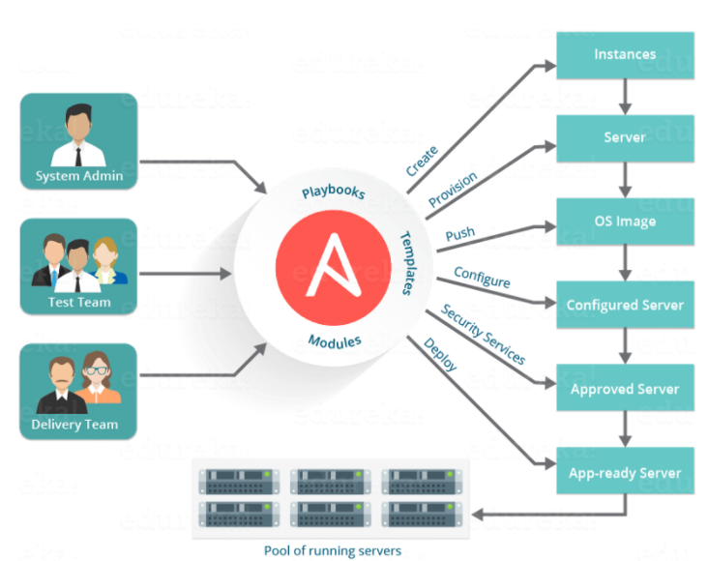
Benefits for the Team
Consistency: All servers are configured the same way.
Efficiency: Tasks that used to take hours now take minutes.
Reliability: Errors are logged, and issues can be fixed automatically.
Scalability: Adding more servers is simple – just run the playbook.

Slide 9
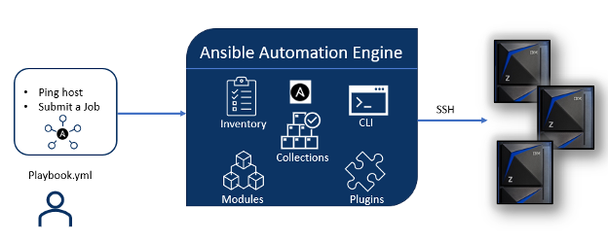
Summary
Ansible automates:
1. Software installation
2. Service management
3. Error handling
4. User and group management
We tested changes first on serverc to avoid mistakes.
Servers servera and serverb are now consistent, secure, and easier to manage.

